Slide 1
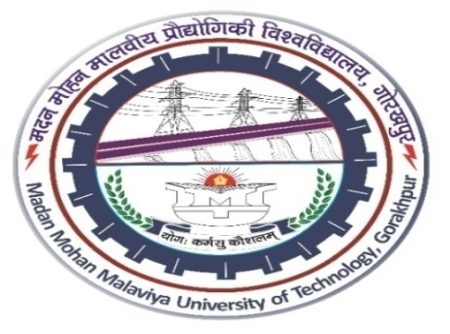
Operating System Concepts (MCA-204) Unit 1
Neha Singh
Department of Information Technology & Computer Application, Madan Mohan Malaviya University of Technology
Gorakhpur-273010,India

Slide 2
Content
Introduction: Basic architectural concepts, Operating System Services, interrupt handling, concepts of batch processing, multiprogramming, time-sharing, real-time operations; Resource Manager view, process view and hierarchical view of an OS.
Memory management: Partitioning, paging, concepts of virtual memory demand paging, page replacement algorithms, segmentation, Segmentation and demand-paging, Cache memory management.

Slide 3
Operating System
Operating system is a collection of set of programs, which manages all the resources of computer system. It is an intermediate between the user and computer hardware.
The Operating System performs basic tasks such as-
Controlling and allocating memory.
Controlling Input and Output device and facilitating networking and managing files.
Examples of Operating System- Windows, Unix, Linux, Mac OS etc.
Characteristics
Scheduling
Memory Management
Security
Interact with different software
Device Management
File Management

Slide 4
Types of Operating System
Batch Operating System
Time Sharing OS
Distributed OS
Network OS
Real Time OS
Multi-Processing OS
Multi-Tasking OS
Multi Programming OS

Slide 5
Advantages
OS provides a GUI interface for the users in the form of menu, icons and buttons.
OS also allow us to sharing the resources with other users.
It helps users to understand the function of a computer.
It is very easy to use.
It can be easily updated.
Disadvantages
If the OS is corrupted than it will affect entire system and computer system will not work.
Only same task run at a time.

Slide 6
Basic Structure of Operating System
User
User
User
Applications
AAAAAPPPPPPPPPPPPPPPPAAAAAaksxkjxskkfjhfjhjhvfvfbmvbfmdnnvbncm
Operating System
Hardware
CPU
I/O
Devices
Secondary
Memory
RAM

Slide 7
Users- Users are layman person or IT professionals who is using the computer to fulfill it’s requirement.
Application- Applications are the software that users wants to use.
Operating System- Act as a bridge/interface between the computer user and it’s hardware.
Hardware- It is the physical part of the computer system, it include CPU, I/O devices, Ram etc.

Slide 8
Operating System Services
An Operating System provides services to both the users and to the programs. It provides programs an environment to execute. It provides users the services to execute the programs in a convenient manner.
Following are a few common services provided by an operating system −
Program execution
I/O operations
File System manipulation
Communication
Error Detection
Resource Allocation
Protection

Slide 9
Program execution
Operating systems handle many kinds of activities from user programs to system programs like printer spooler, name servers, file server, etc. Each of these activities is encapsulated as a process.
Following are the major activities of an operating system with respect to program management −
Loads a program into memory.
Executes the program.
Handles program's execution.
Provides a mechanism for process synchronization.
Provides a mechanism for process communication.
Provides a mechanism for deadlock handling

Slide 10
I/O Operation
An I/O subsystem comprises of I/O devices and their corresponding driver software. Drivers hide the peculiarities of specific hardware devices from the users. An Operating System manages the communication between user and device drivers.
I/O operation means read or write operation with any file or any specific I/O device.
Operating system provides the access to the required I/O device when required.

Slide 11
File System Manipulation
A file represents a collection of related information. Computers can store files on the disk (secondary storage), for long-term storage purpose.
Following are the major activities of an operating system with respect to file management −
Program needs to read a file or write a file.
The operating system gives the permission to the program for operation on file.
Permission varies from read-only, read-write, denied and so on.
Operating System provides an interface to the user to create/delete files.
Operating System provides an interface to the user to create/delete directories.
Operating System provides an interface to create the backup of file system.

Slide 12
Communication
In case of distributed systems which are a collection of processors that do not share memory, peripheral devices, or a clock, the operating system manages communications between all the processes.
Following are the major activities of an operating system with respect to communication −
Two processes often require data to be transferred between them both the processes can be on one computer or on different computers, but are connected through a computer network.
Communication may be implemented by two methods, either by Shared Memory or by Message Passing.

Slide 13
Error Handling
Errors can occur anytime and anywhere. An error may occur in CPU, in I/O devices or in the memory hardware. Following are the major activities of an operating system with respect to error handling −
The OS constantly checks for possible errors.
The OS takes an appropriate action to ensure correct and consistent computing.
Resource Management
In case of multi-user or multi-tasking environment, resources such as main memory, CPU cycles and files storage are to be allocated to each user or job. Following are the major activities of an operating system with respect to resource management −
The OS manages all kinds of resources using schedulers.
CPU scheduling algorithms are used for better utilization of CPU

Slide 14
Protection
Protection refers to a mechanism or a way to control the access of programs, processes, or users to the resources defined by a computer system. Following are the major activities of an operating system with respect to protection −
The OS ensures that external I/O devices are protected from invalid access attempts.
The OS provides authentication features for each user by means of passwords.

Slide 15
Interrupt Handling
Interrupt handling is a key function in real-time software. Only those physical interrupts which of high enough priority can be entered into system interrupt table. The software assigns each interrupt to a handler in the interrupt table. An interrupt handler is just a routine containing a sequence of operations.
The routine for handling a specific interrupt is known as the interrupt service routine for the specific interrupt. The RTOS layer often stores a list of the pairs of interrupts and their handlers known as the interrupt table. All interrupt handlers run constant within the background process. Thus, an interrupt can be handled either as a thread or as a sub-process within a task or process.

Slide 16
Concept of Batch Processing-
Batch processing system will work to submit similar kind of job together. In this operating system user do not interact directly with our computer system.
OS defines a job which has predefined sequence of commands, programs and data as a single unit. OS keeps a number a jobs in memory and executes them without any manual information.

Slide 17
Jobs are processed in the order of submission i.e. first come first served fashion. When job completes its execution, its memory is released and the output for the job gets copied into an output spool for later printing or processing.
Operating System
CPU
Job 1
Batch
Job 2
Batch
Job n
Batch

Slide 18
Advantages
Batch processing takes much of the work of the operator to the computer.
It is useful when we, working with large files which can take more time to execute.
Disadvantages
Once the job is submitted, the user did not have any interaction with it.

Slide 19
Multiprogramming
When two or more programs are residing in memory at the same time, then sharing the processor is referred to the multiprogramming. Multiprogramming assumes a single shared processor. Multiprogramming increases CPU utilization by organizing jobs.
Operating system does the following activities related to multiprogramming.
The operating system keeps several jobs in memory at a time.
This set of jobs is a subset of the jobs kept in the job pool.
The operating system picks and begins to execute one of the job in the memory.

Slide 20
Following figure shows the memory layout for a multiprogramming system.
Operating System
Job 1
Job 2
:
:
:
Job n
Empty Space

Slide 21
Advantages
High and efficient CPU utilization.
User feels that many programs are allotted CPU almost simultaneously.
Disadvantages
CPU scheduling is required.
To accommodate many jobs in memory, memory management is required.

Slide 22
Time –Sharing
The time sharing operating system works with time sharing concept.
Here, the CPU will provide a same time period to each an every process to complete its task as soon as possible weather it is a long process or short process.
CPU
Process 1
Process 4
Process 2
Process 5
Process 3
Process 6

Slide 23
Advantages of Time sharing
Provide advantage of quick response.
Avoids duplication of software.
If the process of a task is completed, then the time between the other tasks increases.
Disadvantages of Time sharing
Sometimes in this operating system there may be a problem of data communication.

Slide 24
Real-Time Operations-
Real time operating system is very useful where we required a quick response for example – missile systems, where the missile has to be launched at certain time.
In this operating system CPU provides maximum effort's to its task with quick response. There are two types of real-time operating systems-
Hard Real-Time Systems- Hard real-time systems guarantee that critical tasks complete on time is called hard real-time systems.
Soft Real-Time Systems- Soft real time systems are less restrictive. Soft real time systems does not guarantee that a job will be complete within a specified time period.

Slide 25
Advantages of Real Time System
Real time operating system provide a quick response hence, generally used in scientific engineering NASA and many more organization.
Disadvantages of Real Time System
These operating system is very costly.

Slide 26
Resource Manager View
The operating system is the resource manager view i.e. it can manage the resource of a computer system internally. The resources are processor, memory, files, and I/O devices. In this role, the operating system keeps track of the status of each resource, and decides who gets a resource, for how long and when.
The operating system can be viewed as a resource allocator. A computer system consists of many resources like - hardware and software - that must be managed efficiently. The operating system acts as the manager of the resources, and controls the execution of programs, etc.

Slide 27
Process View
Process is the execution of a program that performs the actions specified in that program. It can be defined as an execution unit where a program runs. The OS helps you to create, schedule, and terminates the processes which is used by CPU. A process created by the main process is called a child process.
Process operations can be easily controlled with the help of PCB(Process Control Block). You can consider it as the brain of the process, which contains all the crucial information related to processing like process id, priority, state, CPU registers, etc.

Slide 28
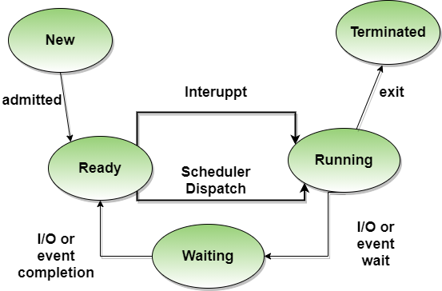
Process Life Cycle

Slide 29
Processes in the operating system can be in any of the following states:
NEW- The process is being created.
READY- The process is waiting to be assigned to a processor.
RUNNING- Instructions are being executed.
WAITING- The process is waiting for some event to occur(such as an I/O completion or reception of a signal).
TERMINATED- The process has finished execution

Slide 30
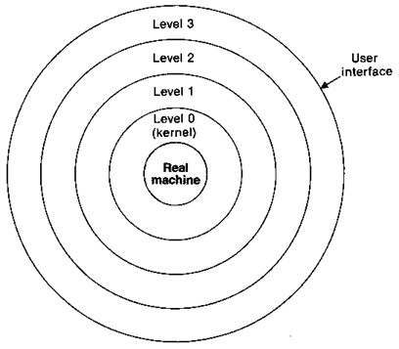
Hierarchical View of OS

Slide 31
Level Functions
3 File Management
2 Memory Management
1 I/O Supervision
0 Resource Management
Each layer or level of the structure can use the functions provided by lower levels just as if they were part of the real machine.
Level 0, often called the kernel of the operating system, deals directly with the underlying hardware.
User program deals with the highest-level interface.
Operating system routines at a given level can use the relatively simple functions and interfaces provided by lower levels.

Slide 32
The operating system can be implemented and tested one level at a time, this reduce the complexity of each part of the operating system and makes the tasks of implementation and debugging much simpler.
In a strict hierarchy each level may refer only to the level immediately beneath it.
This approach has advantage of simplicity of use, however such a restriction can lead to inefficiency because it increases the number of calls that must be performed to reach the inner level.

Slide 33
Memory Management
Memory Management is the process of controlling and coordinating computer memory, assigning portions known as blocks to various running programs to optimize the overall performance of the system.
It is the most important function of an operating system that manages primary memory. It helps processes to move back and forward between the main memory and execution disk. It helps OS to keep track of every memory location, irrespective of whether it is allocated to some process or it remains free.

Slide 34
Partitioning
Memory is divided into different blocks or partitions. Each process is allocated according to the requirement. Partition allocation is an ideal method to avoid internal fragmentation.
Below are the various partition allocation schemes :
First Fit: In this type fit, the partition is allocated, which is the first sufficient block from the beginning of the main memory.
Best Fit: It allocates the process to the partition that is the first smallest partition among the free partitions.
Worst Fit: It allocates the process to the partition, which is the largest sufficient freely available partition in the main memory.
Next Fit: It is mostly similar to the first Fit, but this Fit, searches for the first sufficient partition from the last allocation point

Slide 35
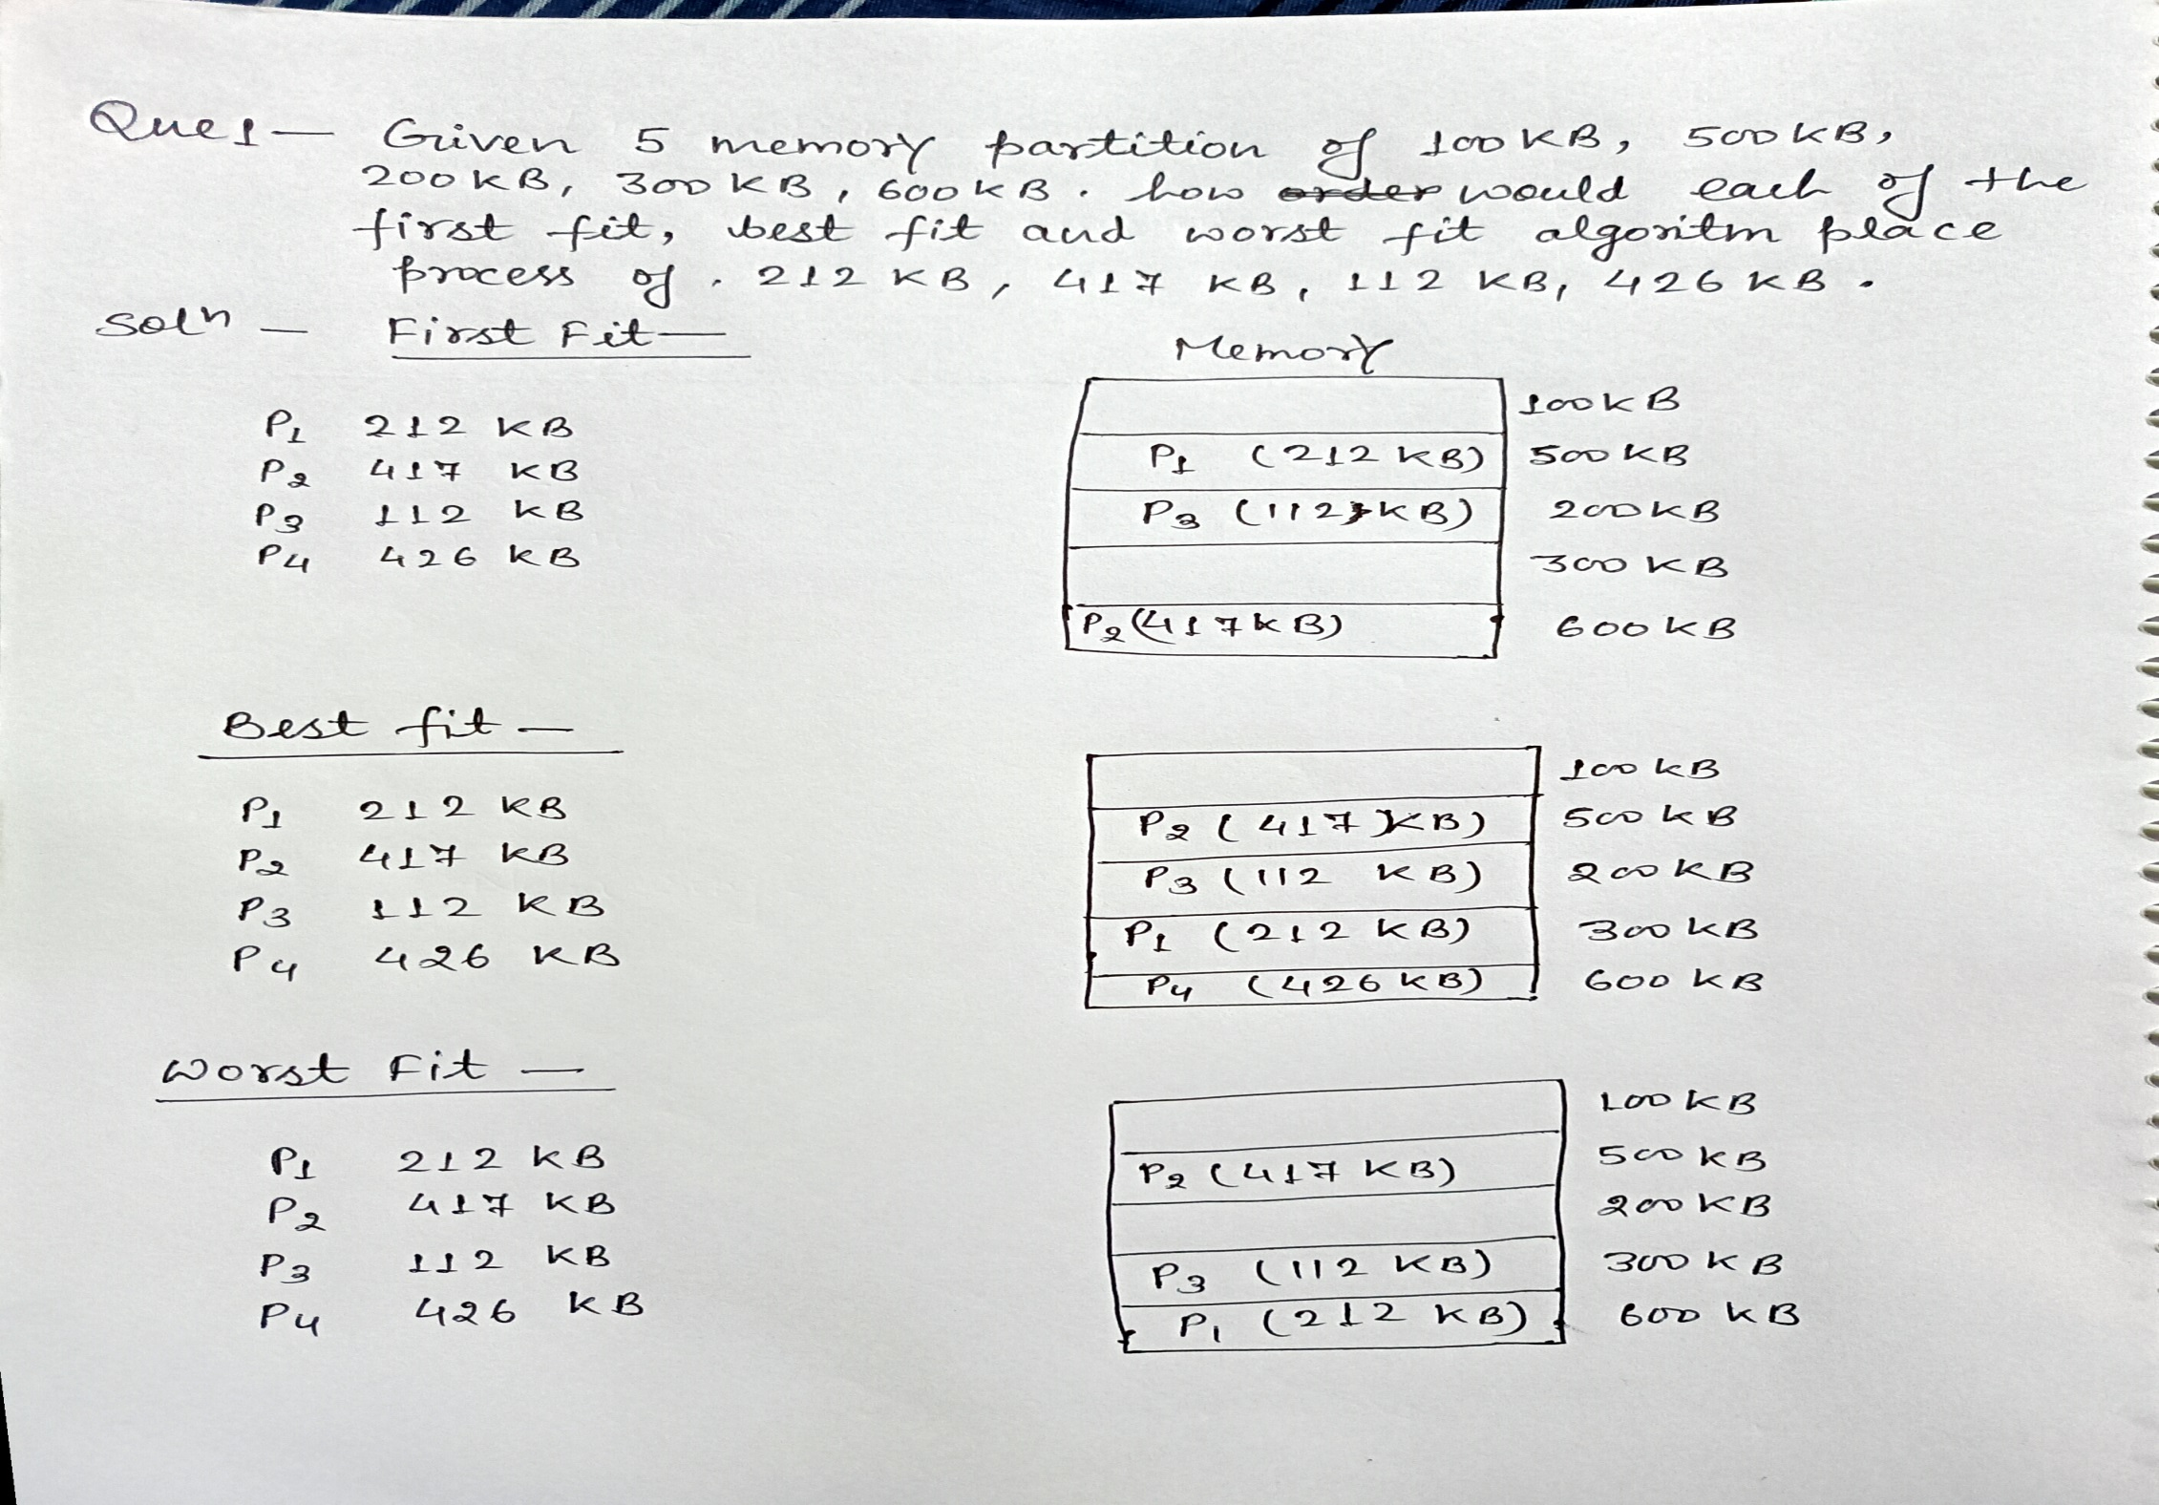

Slide 36
Paging
Paging is a technique in which physical memory is broken into blocks of the same size called pages. When a process is to be executed, it's corresponding pages are loaded into any available memory frames.
Logical address space of a process can be non-contiguous and a process is allocated physical memory whenever the free memory frame is available. Operating system keeps track of all free frames. Operating system needs n free frames to run a program of size n pages. Address generated by CPU is divided into tow parts-
Page number (p) - Page number is used as an index into a page table which contains base address of each page in physical memory.
Page offset (d) - Page offset is combined with base address to define the physical memory address.

Slide 37
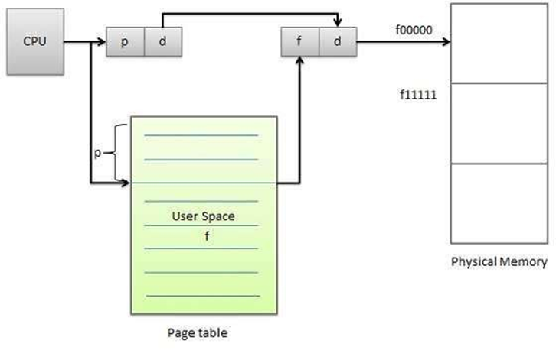

Slide 38
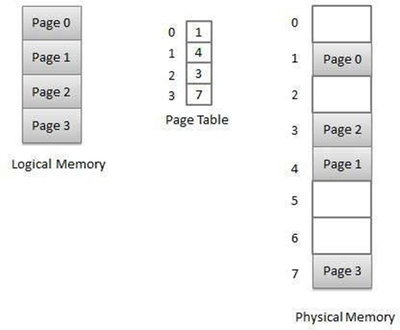
Following figure show the paging table architecture-

Slide 39
Concept of Virtual Memory
Virtual memory is a technique that allows the execution of processes which are not completely available in memory. The main visible advantage of this scheme is that programs can be larger than physical memory. Virtual memory is the separation of user logical memory from physical memory.
This separation allows an extremely large virtual memory to be provided for programmers when only a smaller physical memory is available. Following are the situations, when entire program is not required to be loaded fully in main memory.

Slide 40
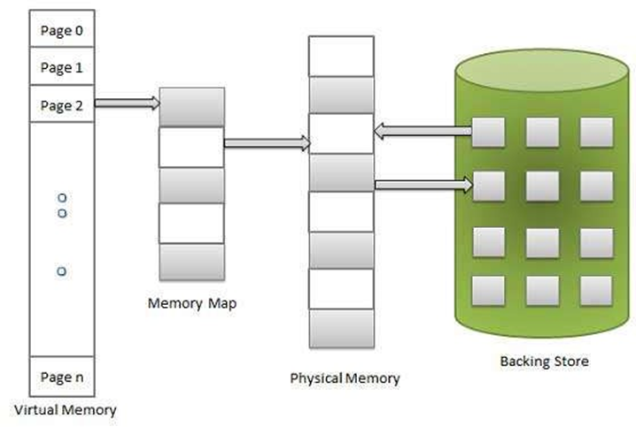

Slide 41
Demand Paging
A demand paging system is quite similar to a paging system with swapping. When we want to execute a process, we swap it into memory. Rather than swapping the entire process into memory, however, we use a lazy swapper called pager.
When a process is to be swapped in, the pager guesses which pages will be used before the process is swapped out again. Instead of swapping in a whole process, the pager brings only those necessary pages into memory. Thus, it avoids reading into memory pages that will not be used in anyway, decreasing the swap time and the amount of physical memory needed.
Hardware support is required to distinguish between those pages that are in memory and those pages that are on the disk using the valid-invalid bit scheme. Where valid and invalid pages can be checked by checking the bit. Marking a page will have no effect if the process never attempts to access the page. While the process executes and accesses pages that are memory resident, execution proceeds normally.

Slide 42
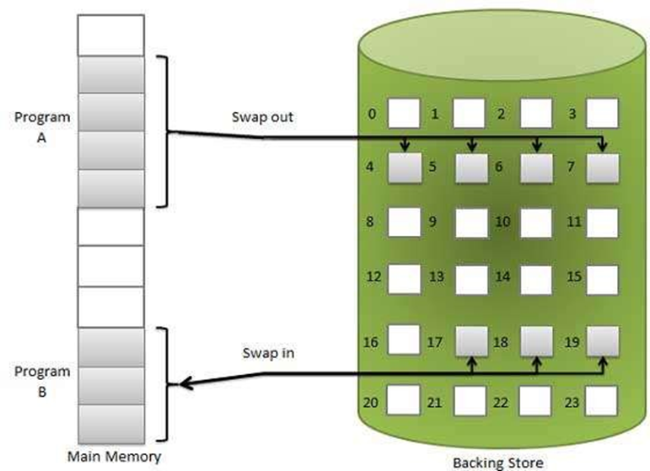

Slide 43
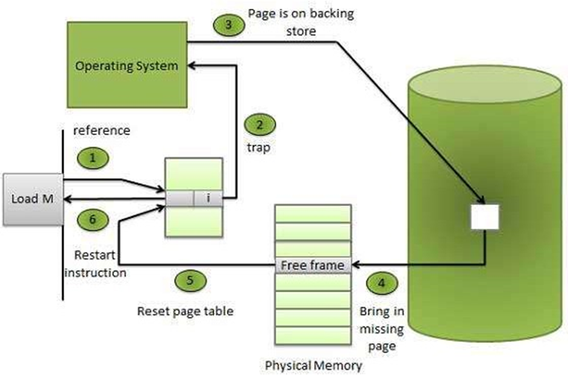
Access to a page marked invalid causes a page-fault trap. This trap is the result of the operating system's failure to bring the desired page into memory. But page fault can be handled as following-

Slide 44
Step 1: Check an internal table for this process, to determine whether the reference was a valid or it was an invalid memory access.
Step 2: If the reference was invalid, terminate the process. If it was valid, but page have not yet brought in, page in the latter.
Step 3: Find a free frame.
Step 4: Schedule a disk operation to read the desired page into the newly allocated frame.
Step 5: When the disk read is complete, modify the internal table kept with the process and the page table to indicate that the page is now in memory.
Step 6: Restart the instruction that was interrupted by the illegal address trap. The process can now access the page as though it had always been in memory. Therefore, the operating system reads the desired page into memory and restarts the process as though the page had always been in memory.

Slide 45
Page Replacement Algorithm
The page replacement algorithm decides which memory page is to be replaced. The process of replacement is sometimes called swap out. Page replacement is done when the requested page is not found in the main memory (page fault).
A page replacement algorithm tries to select which pages should be replaced so as to minimize the total number of page misses. There are many different page replacement algorithms. These algorithms are evaluated by running them on a particular string of memory reference and computing the number of page faults.
If a process requests for page and that page is found in the main memory then it is called page hit, otherwise page miss or page fault.
Page replacement algorithm is mainly three types-
First In First Out (FIFO)
Least Recently Used (LRU)
Optimal Page Algorithm

Slide 46
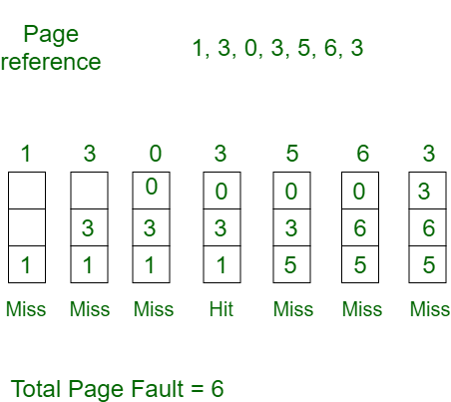
First In First Out (FIFO) Algorithm
Oldest page in main memory is the one which will be selected for replacement.
Easy to implement, keep a list, replace pages from the tail and add new pages at the head.
Example1: Consider page reference string 1, 3, 0, 3, 5, 6 with 3 page frames. Find number of page faults.

Slide 47
Total Hit Pages = 1
Hit Ratio = No of Hit / Total no of References* 100
= 1/ 7 * 100 = 14.2857
Page Fault Ratio = No of Page Fault / Total no of References * 100
= 6/7*100 = 85.7142
Example 2: Consider the page reference string of size 12: 1, 2, 3, 4, 5, 1, 3, 1, 6, 3, 2, 3 with frame size 4(i.e. maximum 4 pages in a frame)
Example 3: Consider the page reference string of size 15: 7, 0, 1, 2, 0, 3, 0, 4, 2, 3, 0, 3, 1, 2, 0 with frame size 3(i.e. maximum 3 pages in a frame)

Slide 48
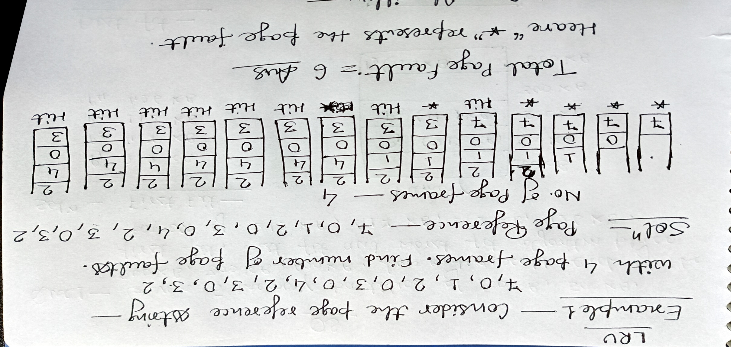
Least Recently Used (LRU) Algorithm
Page which has not been used for the longest time in main memory is the one which will be selected for replacement.
In this algorithm page will be replaced which is least recently used.

Slide 49
Example 2: Consider the page reference string of size 12: 1, 2, 3, 4, 5, 1, 3, 1, 6, 3, 2, 3 with frame size 4(i.e. maximum 4 pages in a frame)
Example 3: Consider the page reference string of size 15: 7, 0, 1, 2, 0, 3, 0, 4, 2, 3, 0, 3, 1, 2, 0 with frame size 3(i.e. maximum 3 pages in a frame)
Optimal Page algorithm
An optimal page-replacement algorithm has the lowest page-fault rate of all algorithms. An optimal page-replacement algorithm exists, and has been called OPT or MIN.
Replace the page that will not be used for the longest period of time .
Example 1: Consider the page reference string of size 12: 1, 2, 3, 4, 5, 1, 3, 1, 6, 3, 2, 3 with frame size 4(i.e. maximum 4 pages in a frame)
Example 2: Consider the page reference string of size 18: 7, 0, 1, 2, 0, 3, 0, 4, 2, 3, 0, 3, 2, 1, 2, 0, 1, 7 with frame size 3(i.e. maximum 3 pages in a frame)

Slide 50
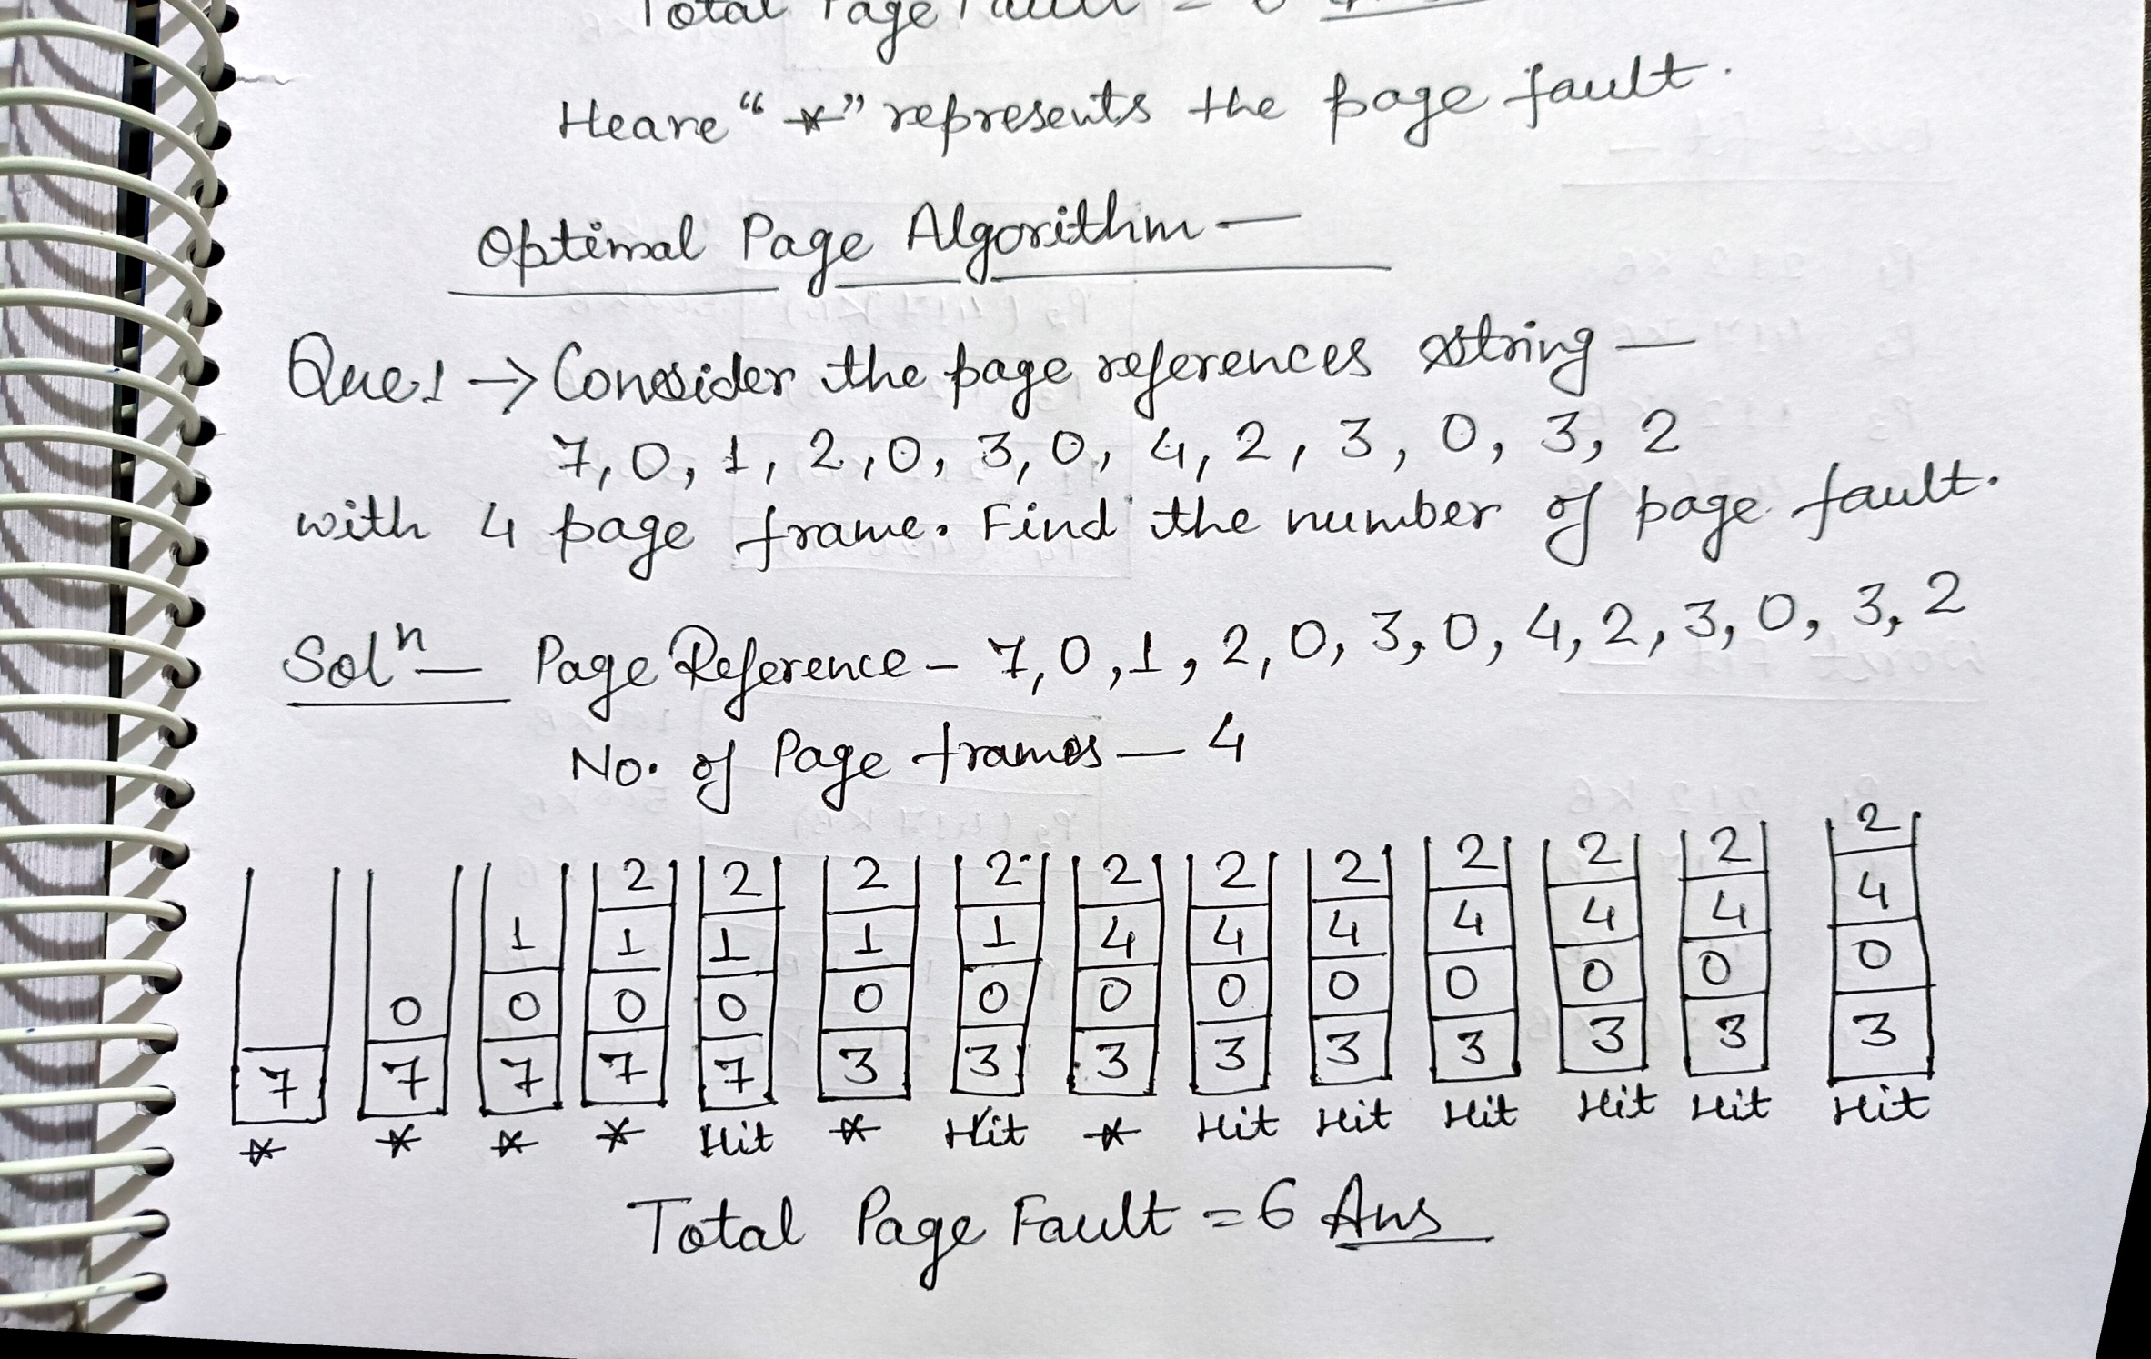

Slide 51
Segmentation
Segmentation is a technique to break memory into logical pieces where each piece represents a group of related information. For example, data segments or code segment for each process, data segment for operating system and so on. Segmentation can be implemented using or without using paging.
Address generated by CPU is divided into tow parts-
Segment number (s) - Segment number is used as an index into a segment table which contains base address of each segment in physical memory and a limit of segment.
Segment offset (o) - Segment offset is first checked against limit and then is combined with base address to define the physical memory address.

Slide 52
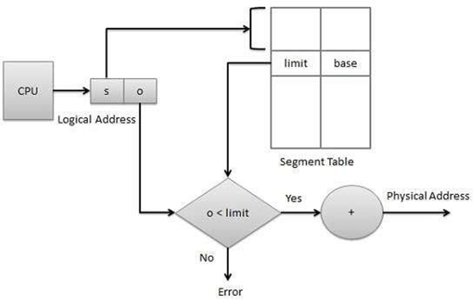

Slide 53
Segmentation and Demand Paging
S.No. | Demand Paging | Segmentation
1. | In demand paging, the pages are of equal size. | While in segmentation, segments can be of different size.
2. | Page size is fixed in the demand paging. | Segment size may vary in segmentation as it grants dynamic increase of segments.
3. | It does not allows sharing of the pages. | While segments can be shared in segmentation.
4. | In demand paging, on demand pages are loaded in the memory. | In segmentation, during compilation segments are allocated to the program.
5. | Page map table in demand paging manages record of pages in memory. | Segment map table in segmentation demonstrates every segment address in the memory.
6. | It provides large virtual memory and have more efficient use of memory. | It provides virtual memory and maximum size of segment is defined by the size of memory.

Slide 54
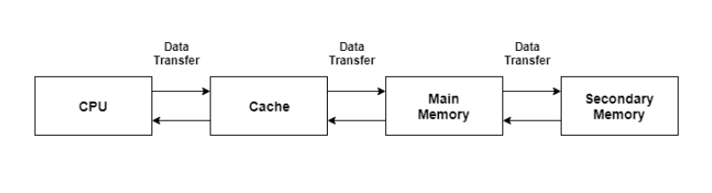
Cache Memory Management
Cache is a type of memory that is used to increase the speed of data access. Normally, the data required for any process resides in the main memory. However, it is transferred to the cache memory temporarily if it is used frequently enough.
A diagram to better understand the data transfer in cache management is as follows −

Slide 55
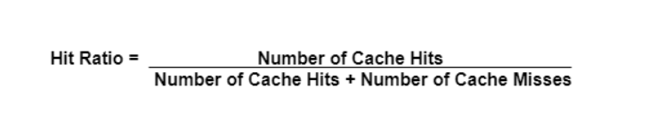
Cache Performance
The cache performance can be explained using the following steps −
If a process needs some data, it first searches in the cache memory. If the data is available in the cache, this is termed as a cache hit.
If the data is not in the cache then it is termed as a cache miss. Then the data is obtained from the main memory. After that the data is transferred to the cache memory.
The performance of the cache is measured using the hit ratio. It is the number of cache hits divided by the total cache accesses. The formula for this is:

Slide 56
Types of Cache Memory
There are mainly two types of cache memory i.e. primary cache and secondary cache.
Primary Cache
Primary cache is very fast and its access time is similar to the processor registers. This is because it is built onto the processor chip. It is also known as a level 1 cache and is build using static RAM (SRAM).
Secondary Cache
The secondary cache or external cache is cache memory that is external to the primary cache. It is located between the primary cache and the main memory. It is also known as a level 2 cache.

Slide 57
Advantages of Cache Memory
Cache memory is faster than main memory as it is located on the processor chip itself.
The memory access time is considerably less for cache memory as it is quite fast. This leads to faster execution of any process.
The cache memory can store data temporarily as long as it is frequently required.
Disadvantages of Cache Memory
it is quite expensive.

Slide 58
THE END

